Slide 1
The
Wright Brothers
Presented by David M Rogers
In METC-106
Intro to Engineering Technology
Ivy Tech Community College

Slide 2
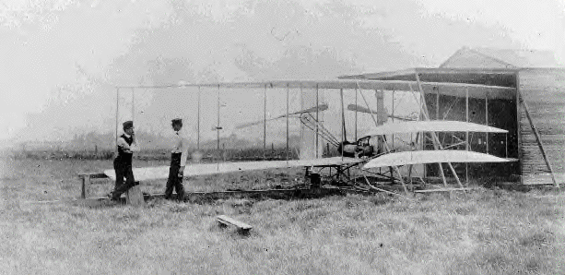
The
Wright Brothers
Orville and Wilbur
Inventors of Airplane and Manned Flight

Slide 3
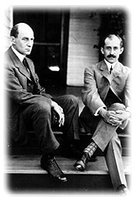
Who are the Wright Brothers
Wilbur born April 16th, 1867
  Steady, thoughtful, perseverant brother
  Born in Millville, IN
  Did not attend college
Orville born August 19th, 1871
  Creative, enthusiastic brother
  Born in Dayton, OH
  Started Printing business while in high school

Slide 4
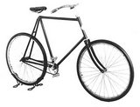
Before They Were Famous:
Orville starts Printing business in 1886
  Eventually childhood friend Ed Sines takes over.
Orville publishes “The West Side News” newspaper in1889. Wilbur joins as editor.
  Fails after a few months as a daily paper.
Wilbur starts bicycle sales and repair shop in 1892.
  Orville joins him shortly after.
  Design “St. Clair” and “Van Cleave” bicycles in 1895
Brothers take interest in “flight problem” after hearing of famous glider, Otto Lilienthal’s death in 1896.
“Van Cleave”

Slide 5
The Day it all Changed: 12-17-1903
The Wright brothers make the first controlled, sustained, powered flight at Kitty Hawk, NC
  1st Flight was 12 seconds long and went 120 feet.
    Approx. 6.8 mph
  4th and best flight of day was 59 seconds long and flew 852 feet.
    Approx. 9.8 mph
"This flight lasted only 12 seconds, but it was nevertheless the first in the history of the world in which a machine carrying a man had raised itself by its own power into the air in full flight, had sailed forward without a reduction in speed, and had finally landed at a point as high as that from which it began.“ -Orville Wright-

Slide 6

History is Made:

Slide 7
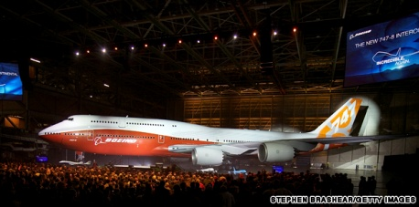
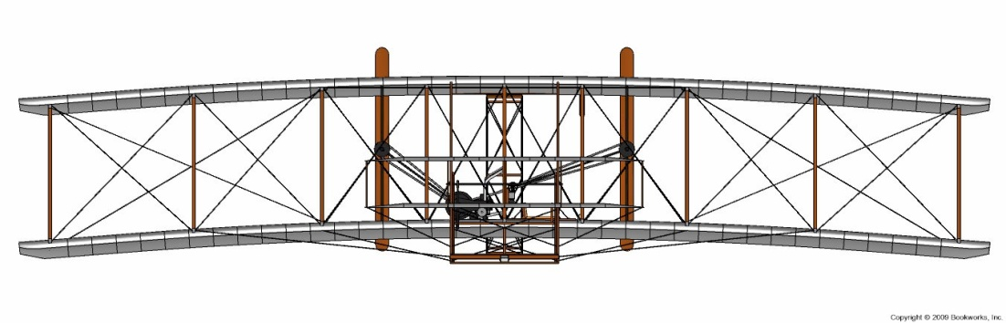
Engine Comparison:
Boeing 747-8l
The Flyer
 | Wright Bros Plane | Boeing 747 8l
Total Engine HP | 12 HP | ~ 90,000 HP
Engine Weight | ~ 180 lbs | 12,400 lbs
Top Speed | ~ 30 mph | ~ 600 mph (cruising)

Slide 8
Advancements From Wright Bros
Boeing 747-8 can carry almost 500 passengers up to 8000 miles.
Mankind has walked on the moon.
Goods and food products are able to be transported all over world.
Completely changed the rules of warfare.
Set in place foundation for Globalization to take place.

Slide 9
Works Cited:
http://www.travel.cnn.com
http://www.firstflight.org
http://en.wikipedia.org
http://www.countdowntokittyhawk.com
http://www.notablebiographies.com
http://www.aerospaceweb.org
http://www.wright_brothers.org

